Slide 1
Introduction to FHIR
Grahame Grieve
Oct 29, 2013

Slide 2
John Halamka, Plenary
Fast Healthcare Interoperability Resources (FHIR) using JSON is the simple HTML for healthcare that does not require knowledge of the HL7 RIM
Although CCDA and Direct are a reasonable starting point and will exist for many years, FHIR/JSON and REST/OAuth2/OpenID is where we need to be.
http://geekdoctor.blogspot.com.au/2013/09/the-hl7-annual-meeting.html

Slide 3
Content
Brief Introduction to FHIR
Project Timeline & Ballot Status
What can you do with FHIR?
Collaborations
What’s in the future?

Slide 4

An instigator of bad puns
FHIR is the hottest thing since . . .
This spec is spreading like . . .
Committee X is really on FHIR
Feel free to come up with your own

Slide 5
FHIR Manifesto
Focus on Implementers
Leverage cross-industry web technologies
Target support for common scenarios
Require human readability as base level of interoperability
Support multiple paradigms & architectures
Make content freely available
Demonstrate best practice governance
Notes:
We don’t actually have a formal manifesto, but these are the principles we adhere to.

Slide 6
Implementer Focus
Specification is written for one target audience: implementers
Rationale, modeling approaches, etc. kept elsewhere
Multiple reference implementations from day 1
Publicly available test servers
Starter APIs published with spec
C#, Java, Delphi, Javascript, XSLT…
Connectathons to verify specification approaches
Valid Instances you can read and understand ☺
using HL7.Fhir.Instance.Model;
using HL7.Fhir.Instance.Parsers;
using HL7.Fhir.Instance.Support;
XmlReader xr = XmlReader.Create(
new StreamRead
IFhirReader r = new XmlFhirReader
// JsonTextReader jr = new JsonTe
// new StreamRead
// IFhirReader r = new JsonFhirRe
ErrorList errors = new ErrorList(
LabReport rep = (LabReport)Resour
Assert.IsTrue(errors.Count() == 0
Notes:
Who’s read the v3 spec? – modeler & balloter focused
Spec is driven by people who write code
Numerous pieces have been changed because of experience with what worked when trying to implement
Even have a test workbench for RESTful servers

Slide 7
Web technologies
Instances shared using XML & JSON
Collections represented using ATOM
Same technology that gives you your daily news summary
Out-of-the-box publish/subscribe
Web calls work the same way they do for Facebook & Twitter
Rely on HTTPS, OAuth, etc. for security functions
http://...
Notes:
We try very hard to *not* invent stuff that exists elsewhere unless it’s really broken or totally unaligned with the FHIR principles.

Slide 8
Support “Common” Scenarios
80%
Inclusion of content in core specification is based on core rule
“We only include data elements if we are confident that 80% of implementations maintaining that resource will make use of the element”
Other content pushed to extensions
(more on this later)
Easy to say, governance challenge to achieve
Notes:
Design by constraint failed – years to develop, what was produced required yet more design to be implementable and after that might not be interoperable
How to determine the 80%? Look to existing specs – v2, v3, CDA templates, OpenEHR, jurisdictional projects, what implementations we’ve seen
If not sure, err on the side of “not in for now”
Note: not 80% of instances, 80% of implementations
Challenges with “raising the bar”
What happens when there aren’t many/any implementations?

Slide 9

Human Readable
A very important lesson from CDA
Even if the computers don’t understand 99% of what you’re sending, that’s ok if they can properly render it to a human clinician
This doesn’t just hold for documents – important for messages, services, etc.
In FHIR, every resource is required to have a human-readable expression
Can be direct rendering or human entered
Notes:
Even when you think your target will understand all the encoded data, reality is data often gets shared beyond the originally intended context
Allow for exceptions for things like automated device readings, etc.

Slide 10
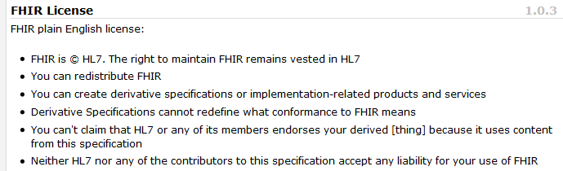
Freely available
Unencumbered – free for use, no membership required
http://hl7.org/fhir
Notes:
Was a bigger deal before HL7 decided to open up all IP
full legal text towards bottom of FHIR home page

Slide 11
Paradigms
FHIR supports 4 interoperability paradigms
REST
Documents
Messages
Services

Slide 12
Paradigms
Regardless of paradigm the content is the same
This means it’s straight-forward to share content across paradigms
E.g. Receive a lab result in a message. Package it in a discharge summary document
It also means constraints can be shared across paradigms
E.g. Define a profile for Blood Pressure and use it on resources in messages, documents, REST and services

Slide 13


Resources
“Resources” are:
Small logically discrete units of exchange
Defined behaviour and meaning
Known identity / location
Smallest unit of transaction
“of interest” to healthcare
V2: Sort of like Segments
V3: Sort of like CMETs

Slide 14
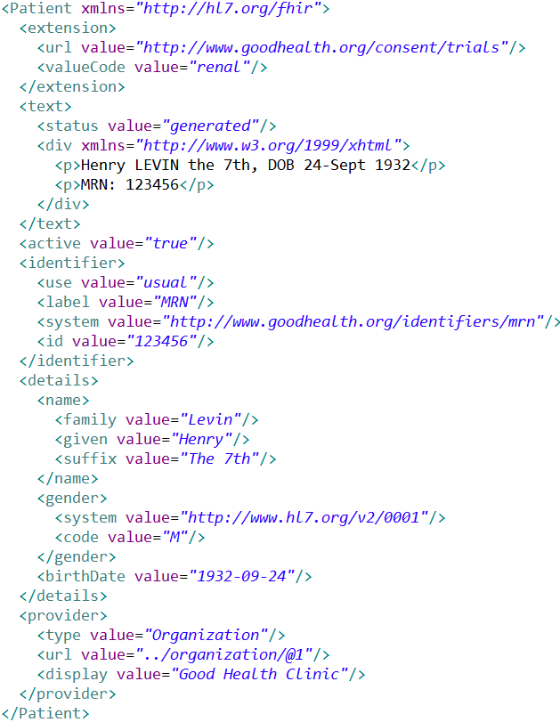
Extension with reference to its definition
Human Readable Summary
Standard Data Content:
MRN
Name
Gender
Date of Birth
Provider
Notes:
System for gender is wrong . . .

Slide 15
It’s all about the resources . . .
Location
Lab
Report
Related
Person
Patient
Practitioner

Slide 16
Manageable Extensibility
Extensions are built into the wire format
All conformant systems can “handle” any possible extension - Just a bucket of “other stuff”
Use modifierExtensions for extensions that “change things”
Require formal definitions of extensions to be available in interoperability space
Extensions rendered in human readable portion

Slide 17
Project Timeline

Slide 18
FHIR Project Timeline
First invented July 2011
First presented San Diego Sept 2011
Draft for Comment Sept 2012
Connectathons since Sept 2012
DSTU Ballot Sept 2013
Expected DSTU publication in Jan 2014

Slide 19
Project Team
Governance – 7 people
Management group – 11 people
Core project team – 4 people
Contributers / Editors – many committers
Testers / Implementers – 100+ people
Connectathons!

Slide 20
What can you do with FHIR?

Slide 21
What you can do
REST is inherently a platform – a capability
All sorts of collaborations are possible using the base API

Slide 22
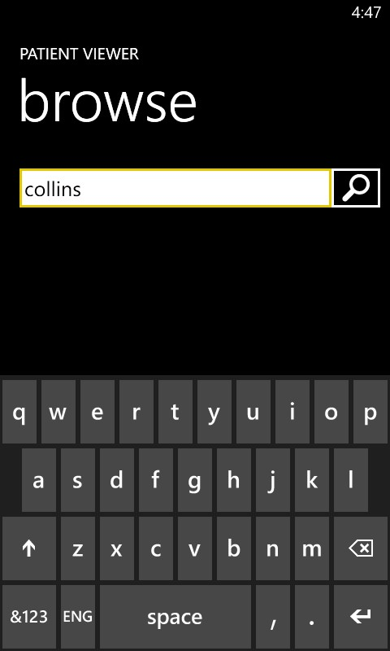
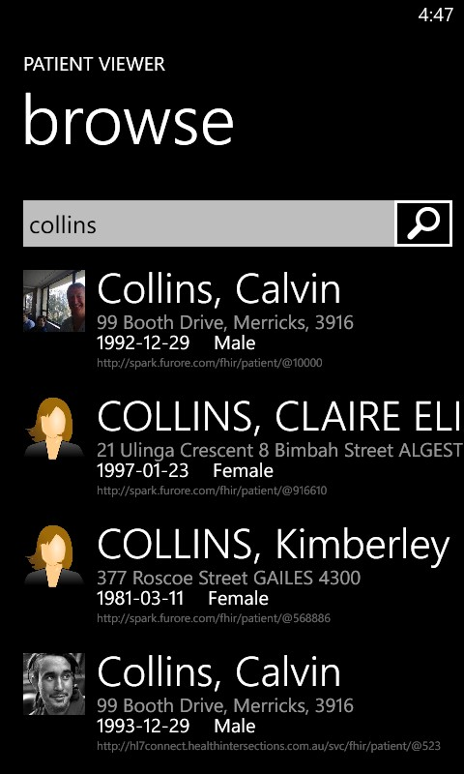

Slide 23
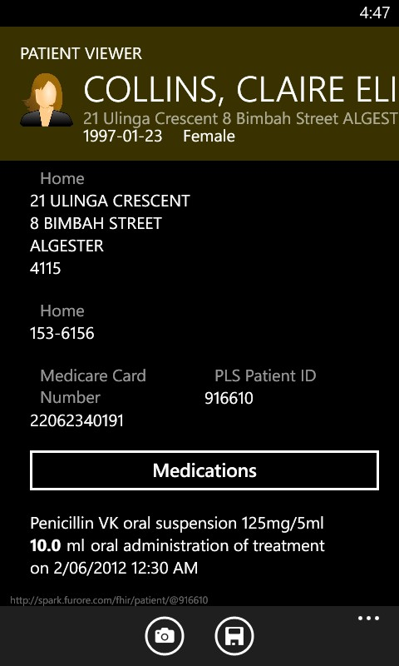
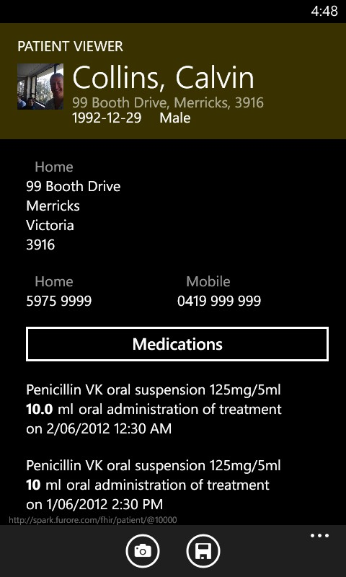

Slide 24
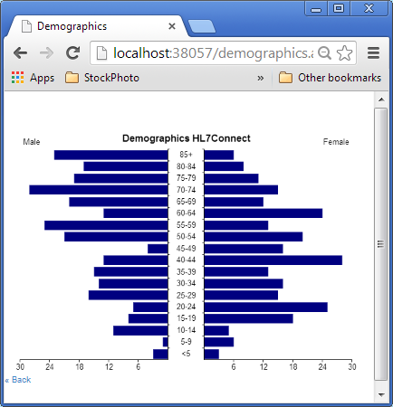
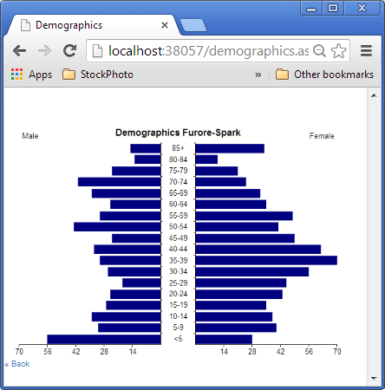
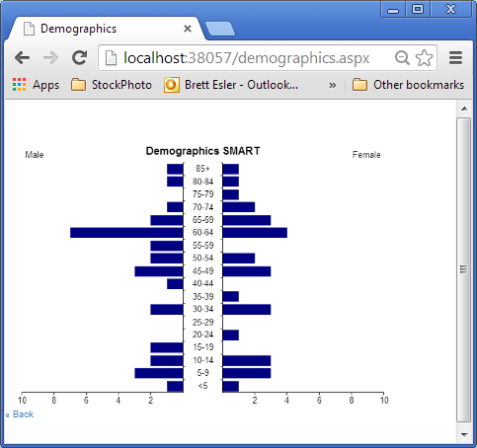
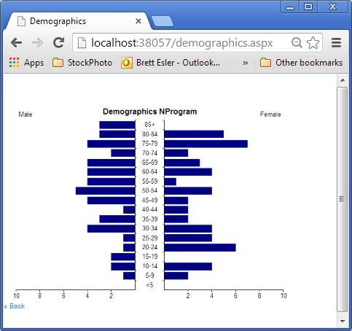
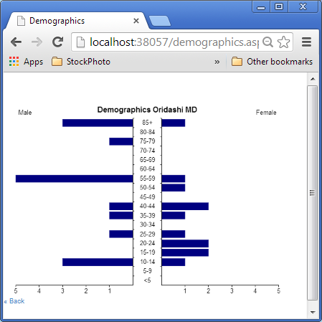
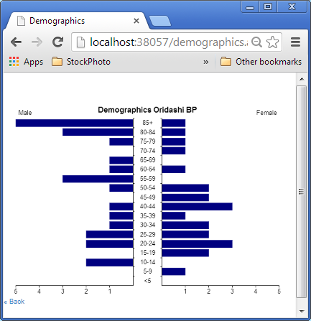
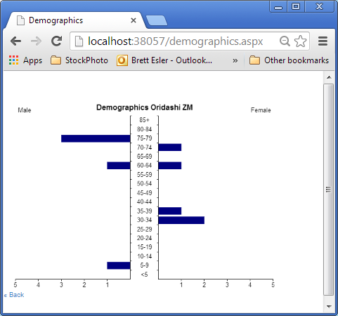
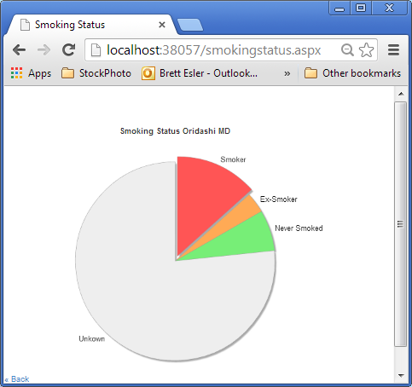
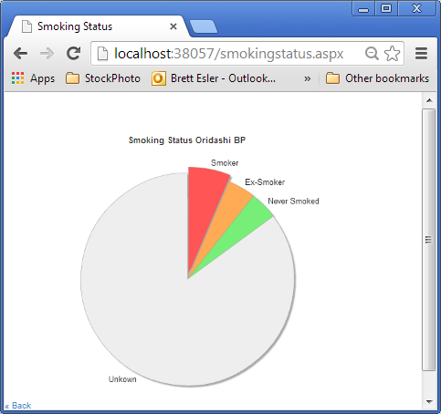
Click and Play Client from Base URL
Australian, Dutch, US and UK servers
3 Australian GP Systems wrapper servers

Slide 25
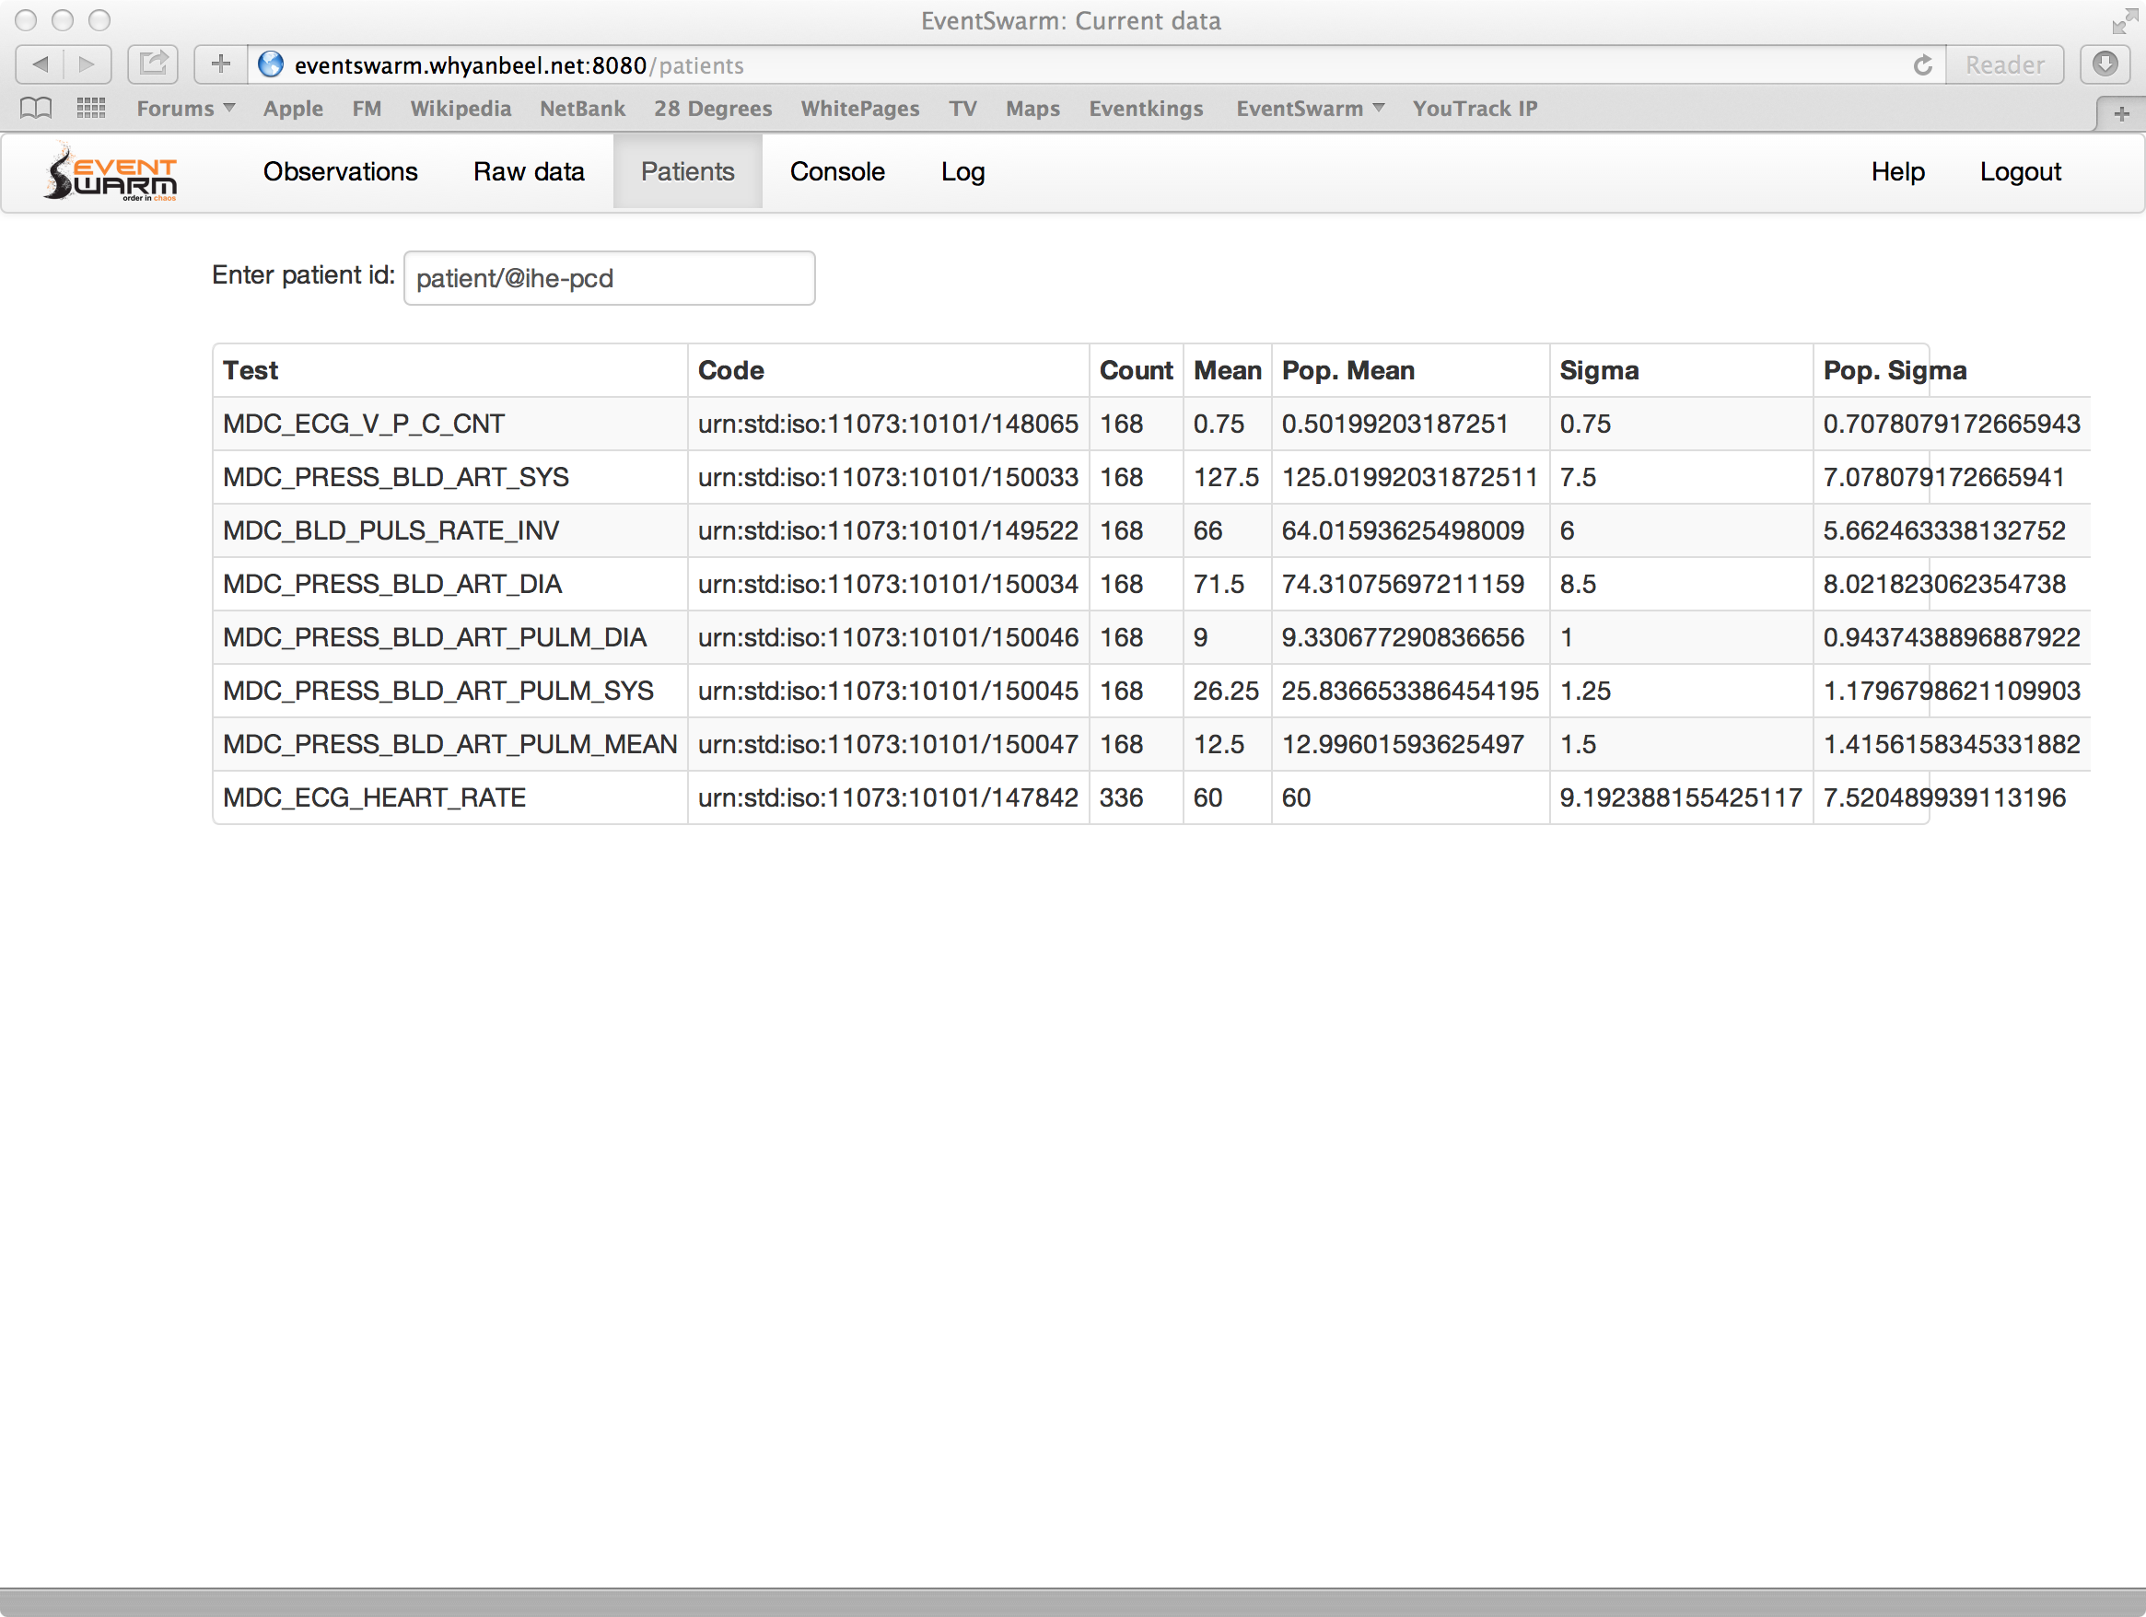

Slide 26
You can do anything…
Which has it’s downside: what do you do?
There’s going to be need for implementation guides to make choices
FHIR is an international platform specification
Will be realm and domain guides

Slide 27
Collaborations

Slide 28
Collaborations
IHE
XDS – MHD, ATNA
DICOM
Exposing Images (WADO-RS) to clinical context
W3C
Enabling knowledge processing (repository of all health data and knowledge)

Slide 29
What’s in the future?

Slide 30
Future
Jan 2014 – publish the DSTU
Through 2014:
Implementation & Evangelisation Activities
Add to DSTU (Sept?): Additional resources
Through 2015
More
+ start preparing normative ballot?

Slide 31
Future
Impact of FHIR on the market:
Drive interoperability prices down
Higher Expectations
Increased spend on integration (N x 2!)
Overall Market focus
PHR + SMAC
Healthcare repositories (MHD+)
Device Data management
Retooling existing connections

Slide 32
FHIR & Cost of Integration
FHIR is designed for implementers
Written to be understood and implemented
Resources are described in the language of the problem
Quality and Consistency is in the background
Version Stability inherent
1000s of examples
Implementation assistance (code etc)
Live Servers, Regular Connectathons

Slide 33
FHIR & Cost of Integration
FHIR re-uses technology
Copy Facebook, Google, Twitter etc
Work with W3C
Skills & Libraries are easily available
RESTful API is re-usable
Push / Pull / Subscribe / Search
Build on top of it

Slide 34
FHIR & Cost of Integration
FHIR is free and accessible
No limitations on use or distribution
Published as a website (direct linking)
Tutorials, Documentation published under open licenses

Slide 35
FHIR & Cost of Integration
These factors will drive down the cost of integration and interoperability
Easier to Develop
Easier to Troubleshoot
Easier to Leverage in production
More people to do the work (less expensive consultants)
Competing approaches will have to match the cost, or disappear – effect is already being felt

Slide 36
Future
Impact of FHIR on the market:
Drive interoperability prices down
Higher Expectations
Increased spend on integration (N x 2!)
Overall Market focus
PHR + SMAC
Healthcare repositories (MHD+)
Device Data management
Retooling existing connections

Slide 37
Future Challenges
Still a lot of missing coverage
A lot of clinical content to cover
Leverage CCDA knowledge
Still missing infrastructure
A way to collate & organise content
Additional tooling still needed
Impact on community
New people come to HL7
Governance Problems kicked down the road

Slide 38
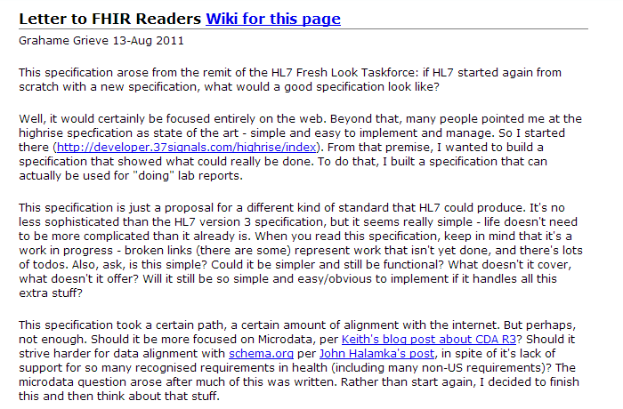

Slide 39
FHIR Manifesto
Focus on Implementers
Leverage cross-industry web technologies
Target support for common scenarios
Require human readability as base level of interoperability
Support multiple paradigms & architectures
Make content freely available
Demonstrate best practice governance
Notes:
We don’t actually have a formal manifesto, but these are the principles we adhere to.

Slide 40
FHIR
http://hl7.org/fhir
Twitter: #FHIR
Notes:
We don’t actually have a formal manifesto, but these are the principles we adhere to.

